Slide 1
Understanding and Using Terminology in HL7 FHIR
Rob Hausam MD
HL7 Working Group Meeting
San Antonio, Texas
2019-01-16

Slide 2

This presentation
Can be downloaded here:
https://github.com/FHIR/documents/blob/master/presentations/2019-01%20Tutorials/FHIR%20Terminology%20-%20San%20Antonio%20WGM%202019-01-16.pptx
Is licensed for use under the Creative Commons, specifically:
Creative Commons Attribution 3.0 Unported License
(Do with it as you wish – just give credit)
Acknowledgements: Grahame Grieve, Lloyd McKenzie

Slide 3
Who am I?
Name: Rob Hausam MD
Company: Hausam Consulting LLC
Background:
Co-chair of Vocabulary and Orders and Observations WGs
FHIR specification and Terminology Module editor
Actively involved in HL7 and terminology standards/development and modeling for 16+ years

Slide 4
Who Are You?
Background
Technical (e.g. developer, architect)
Clinical (e.g. physician, nurse, pharmacist)
Non-technical (e.g. manager, CEO)
Familiar With Terminologies?
SNOMED CT, LOINC, ICD, etc.
Familiar with FHIR?

Slide 5
Who Are You?
Familiar with Other Information Model Standards?
V2, V3, CDA, OpenEHR, etc.
Taken other HL7 Vocabulary training/tutorials?

Slide 6
What Are Your Questions?

Slide 7
What Are Your Questions?

Slide 8
Tutorial Learning Objectives
Understand how coded data is represented in data types and model elements and is exchanged in FHIR resources
Know how code systems and value sets in FHIR are defined and understand how they are used
Understand terminology binding and how to specify and use it correctly in FHIR models (resources and profiles)
Use FHIR terminology-based searching to find resources based on the content and properties of the coded data

Slide 9
Tutorial Learning Objectives
Be able to understand and use FHIR Terminology Service capabilities (operations) in multiple scenarios
(e.g., terminology validation, user interface concept selection)

Slide 10
where to find Terminology in FHIR

Slide 11
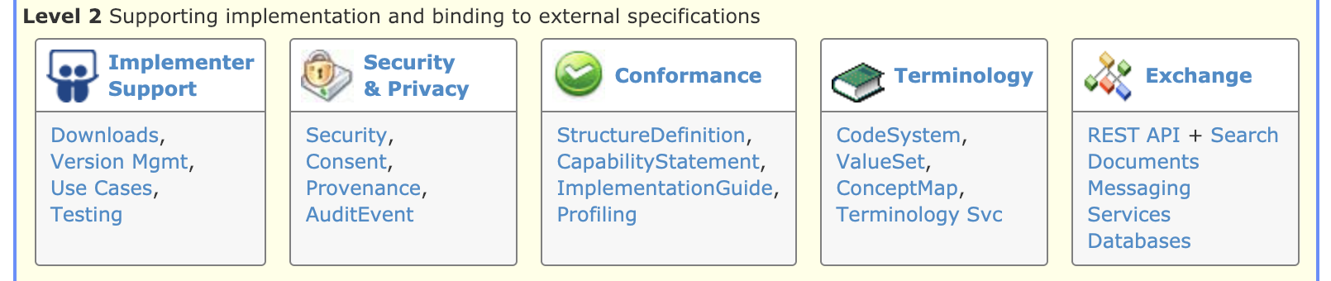
Terminology Module
Level 2 on the Home page
The primary organizing place in the FHIR specification for terminology specifications, guidance and content
http://hl7.org/fhir/terminology-module.html

Slide 12
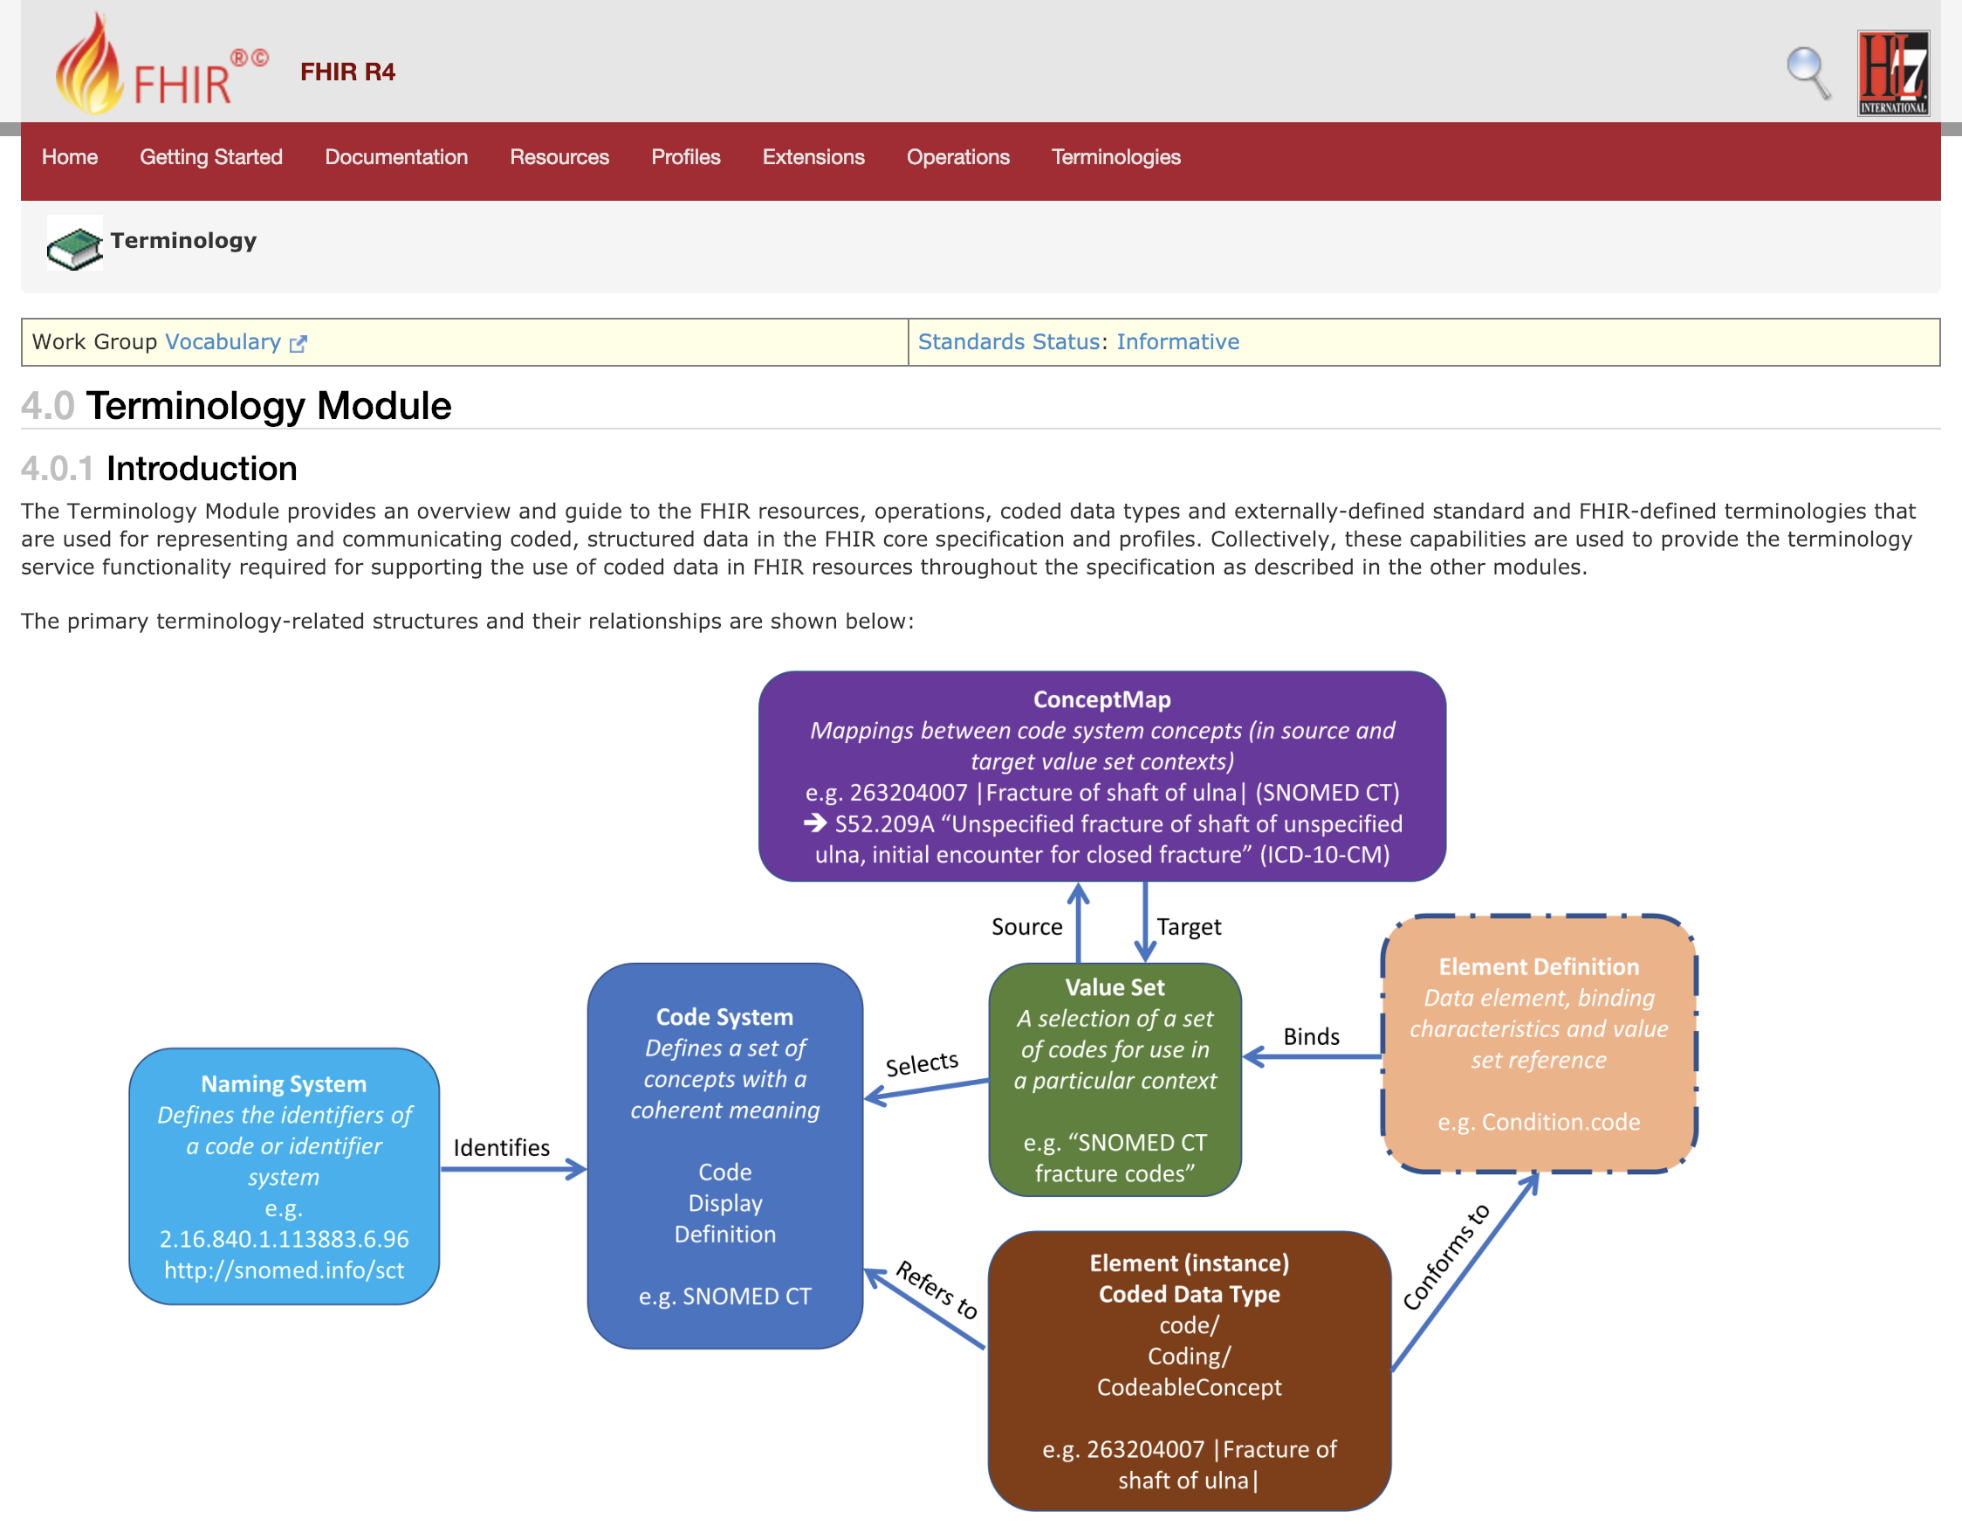



Slide 13

Terminologies link
Terminologies link
The last link on the right in the top-level (red) navigation bar
The quick and easy way to get to the terminology content in the FHIR specification – code systems, value sets, concept maps

Slide 14
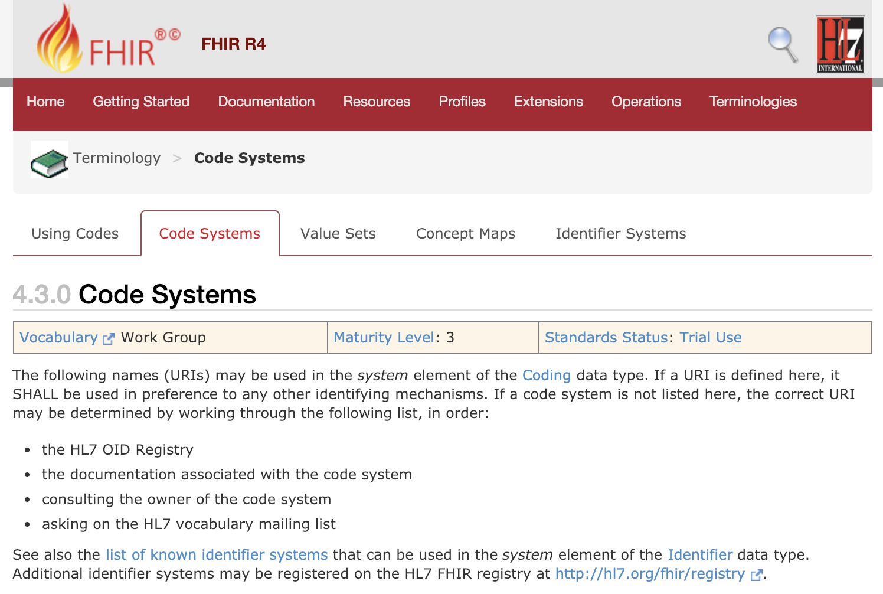

Slide 15

FHIR Zulip chat Terminology stream
https://chat.fhir.org/#narrow/stream/terminology

Slide 16
Representing and exchanging Coded Data

Slide 17
Code System
Code System
Defines a set of concepts with a coherent meaning Code Display
Definition
e.g. SNOMED CT
SNOMED CT / LOINC / ICD-10
RxNorm, NDF-RT, ICPC, ICF, CPT, CVX, NUCC HCPT, ATC, ANZSCO (+ 100s more)
HL7 V2 tables, V3 code systems
A drug formulary
Options for a config table in an application
A list of enums in a java class
Country codes (ISO 3166)

Slide 18
Value Set
Code System
Defines a set of concepts with a coherent meaning Code Display
Definition
e.g. SNOMED CT
Value Set
A selection of a set of codes for use in a particular context
e.g. “SNOMED CT fracture codes”
Selects
“European country codes”
“The LOINC codes that I use”
All LOINC order codes
A particular SNOMED CT hierarchy
Substance codes plus “No known allergy”

Slide 19
Code System vs. Value Set
Why do we need both?
These can be mixed (and misunderstood) in common usage
Especially for a value set that is “all codes” from the code system
A value set can contain codes from more than one code system
But it’s usually not a great idea
Separate the definition of a concept (code system) and the use of a concept (value set)
Keep this straight to avoid getting into trouble when you exchange data

Slide 20
Code System vs. Value Set Take Home Points
Code systems define symbols with specific meanings
E.g. LOINC, SNOMED, ICD-10, IETF language codes, local lab result codes, etc.
Value sets define collections of codes for use in a particular context
E.g. Codes for vital signs, codes for procedures
Can come from a single code system or multiple code systems

Slide 21
Terminology Binding
Element Definition Data element, binding characteristics and value set reference e.g. Condition.code
Code System
Defines a set of concepts with a coherent meaning Code Display
Definition
e.g. SNOMED CT
Value Set
A selection of a set of codes for use in a particular context
e.g. “SNOMED CT fracture codes”
Binds
Selects

Slide 22
More on Bindings
Bindings identify the codes that are allowed to be used for a given element
Bindings can be to a:
Value set
By convention a binding is to a value set – not directly to a code system
Reference (to an “inferred” value set)
E.g. Mime types
Description only
This must be populated if no reference is available

Slide 23
Binding Strength
example: These codes just give an idea of what you might use
No expectation (or recommendation) of use
preferred: You SHOULD use the specified codes
But if you have a good reason, you can use something else instead – it is not required to use the specified codes in order to be conformant
extensible: You must use the specified codes if they apply
Free to use other codes or text if the value set doesn’t cover the concept
required: You must use the specified codes
Or omit the element if no code applies for the concept

Slide 24
Coded Data (instance)
Element Definition Data element, binding characteristics and value set reference e.g. Condition.code
Code System
Defines a set of concepts with a coherent meaning Code Display
Definition
e.g. SNOMED CT
Value Set
A selection of a set of codes for use in a particular context
e.g. “SNOMED CT fracture codes”
Binds
Selects
Element (instance)
Coded Data Type code/ Coding/ CodeableConcept e.g. 263204007 |Fracture of shaft of ulna|
Conforms to
Refers to
There is not a reference from an instance of coded data directly to a value set (except by the valueset-reference extension)

Slide 25
Binding vs. Data element instance
A binding specifies a value set
Observation.code is bound to:
valueSetReference = http://hl7.org/fhir/ValueSet/observation-codes
Definition of ‘observation-codes’ = “This value set includes all LOINC codes”
A data element instance specifies a code system
Observation.code.coding.system = http://loinc.org
Observation.code.coding.code = 15074-8
Observation.code.coding.display = Glucose [Moles/volume] in Blood

Slide 26
Referring to a code system
Each “use of a code” (a reference into a code system) has 4 properties:
system: URL of the code system
version: stated version of the code system (optional)
code: the symbol defined for the concept (code/expression)
display: a human readable representation of the concept (optional – primarily for debugging/display)

Slide 27
URL vs. OID
In v2, you could identify code systems (and identifier systems) in a variety of ways
typically a local string
In v3 you had to use OIDs
E.g. 2.14.1237.937.25.58
In FHIR, we use URLs
E.g. http://myhospital.org/codes/labresults
Can also use urn:oid:2.14.1237.937.25.58
If you really want to ☺
Human-readable
Potentially resolvable
No training required

Slide 28

The ‘code’ Data Type
Just a code
Code system is fixed
Value set is fixed (required binding)
Display name is known
Used for “structural” elements
Essential to fundamental interoperability
Reasonable to standardize at international level
E.g. ‘status’, ‘Bundle.type’, etc.

Slide 29
What if I need a different ‘code’?
‘code’ data elements aren’t extensible
Can’t send your own custom codes
If coded element is optional
Omit the element and just send an extension
If coded element is minOccurs=1
Choose the code closest matching your need
Send additional semantics as an extension
Consider submitting a change request for inclusion in a future version of FHIR

Slide 30

Coding
code + system
Not often used directly
Example: Consent.purpose
In most cases, if you need one Coding, you probably also need translations and/or original text ➔CodeableConcept
Question: Why is everything optional?

Slide 31
Coding – Element Optionality
Version, display and userSelected provide additional optional information
System is present with no code
Means there is no suitable code in the system which can be used to represent the concept
Only the code is present (and not the system)
Could occur, but rare and best avoided
Must be able to infer the system by context or no useful processing can be performed

Slide 32

CodeableConcept
Potentially multiple ‘Coding’ elements, all are “equal”
One can be “user selected”
Coding.userSelected (boolean)
To maximize interoperability, send all of the Codings that you know
Text: Representation of the concept as entered or chosen by the user
Text and Coding.display are fallbacks for systems that don’t recognize your code, so it is good practice to include them

Slide 33
What to use for coded data in an extension?
The default is CodeableConcept – it’s the safest for subsequent migration and interoperability
Use Coding only if translations don’t make sense (not just if you don’t currently have a need)
Use ‘code’ if (and only if):
It is essential that everyone use the same codes
You can define a set of codes that sufficiently cover the space

Slide 34
Codes vs. Identifiers
Coding
Identifier
code
system
display (for code), version, primary, valueSet
Represents a meaning/concept
Can cover real things such as countries, states
value
system
label (for system), use, period, assigner
Represents an “identity”, but can also identify a “kind”

Slide 35
CODE SYSTEM resource
35

Slide 36
CodeSystem
Declares the existence of a code system and its key properties:
Identifying URL and version
Description, copyright, publication date, and other metadata
Whether case sensitive and version safe
Whether a compositional grammar is defined
Filters for use in a ValueSet.compose element
Code system-defined concept properties

Slide 37
CodeSystem
May list some or all of the concepts in the code system, along with their basic properties (code, display, definition), designations, and additional properties
Not intended to support the process of maintaining a code system
Not intended for distributing important existing (large) code systems (SNOMED CT, LOINC, RxNorm, ICD family, etc.)

Slide 38
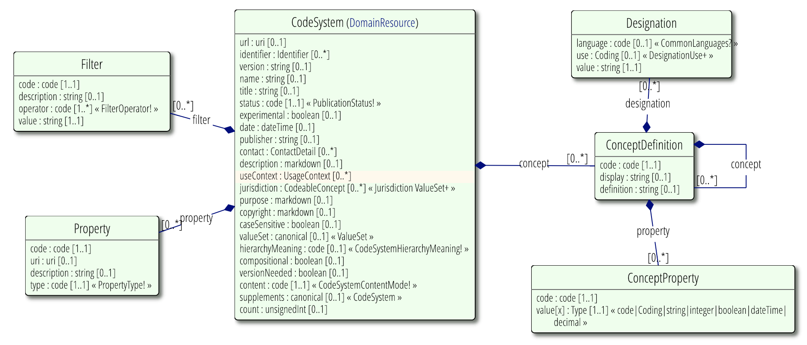
CodeSystem UML
Changed data type to ‘canonical’ in R4
Added ‘supplements’ in R4 – a reference to an additional code system used to “supplement” the primary code system with additional properties, descriptions, etc.

Slide 39
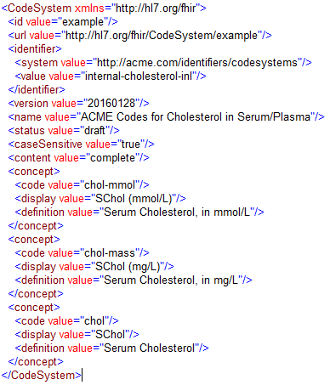
Code system definition example

Slide 40
Value Set Resource
40

Slide 41
ValueSet
Value sets use CodeSystem resources by referring to them via their canonical URLs
Value sets are used in ElementDefinition and Questionnaire resources to specify the allowable contents for coded elements
Aligned with Value Set Definition (VSD) spec
Not all VSD elements are in the base resource
Some are defined as part of ValueSet extensions
ValueSet.compose = VSD "Content Logical Definition” (CLD)

Slide 42
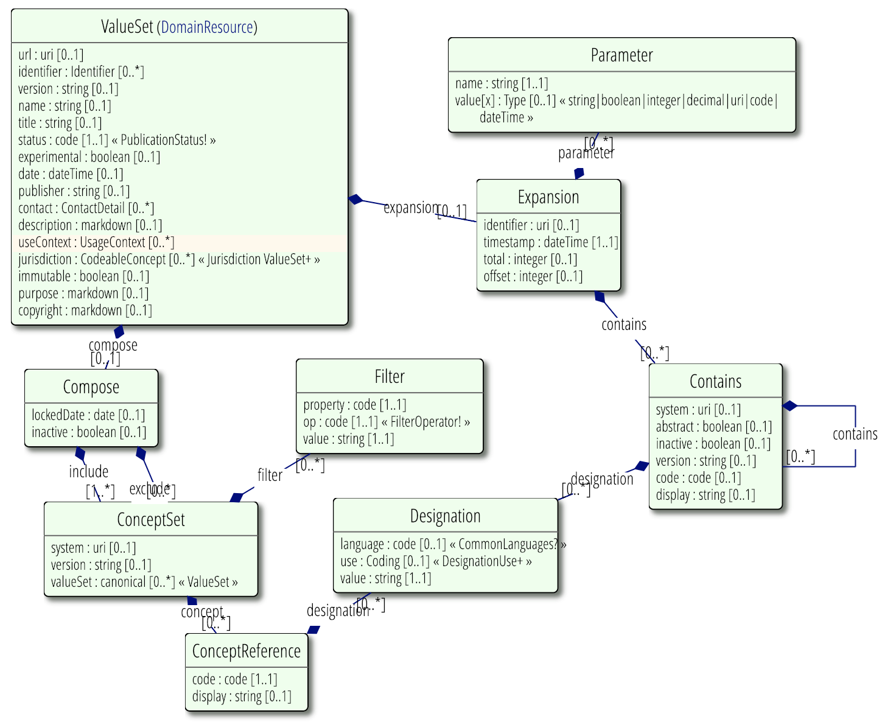
ValueSet UML
Changed data type to ‘canonical’ in R4

Slide 43
Value Set Parts
Meta data
url, identifier, version, name, title, status, experimental, date, publisher, contact, description, useContext, jurisdiction, immutable, purpose, copyright, extensible
Logical definition (.compose):
Codes to include/exclude – by system, list or filter
Specify other value sets to include/exclude
Expansion (.expansion)
What’s actually in the value set today, under local conditions

Slide 44
Value Set Versions
Versions are important to understand and use, when needed
A value set that doesn’t use ValueSet.compose.include.version has unknown content (even if it lists the codes explicitly)
If you don’t decide on a version, the decision and the results are delegated to run time
But, this is a very common thing to do
44

Slide 45
Selecting Concepts
Name the code system (‘system’, with optional ‘version’)
If just a ‘system’, then all codes are included
List codes
Can provide alternate descriptions
Select codes by property (‘filter’)
Property Name – defined by the code system
Operation – ‘=’, ‘is-a’, ‘in’, ‘regex’, etc.
Value – the value of the property
e.g., LOINC: COMPONENT = “Sodium”

Slide 46
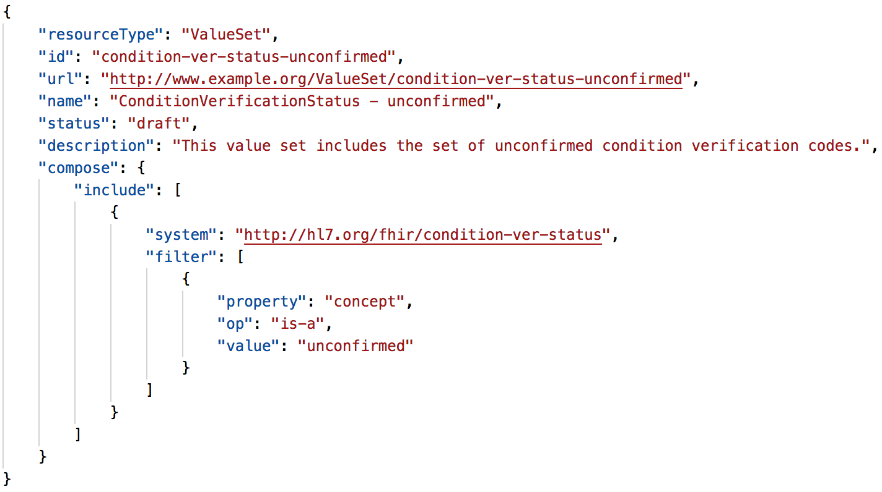
Compose example

Slide 47
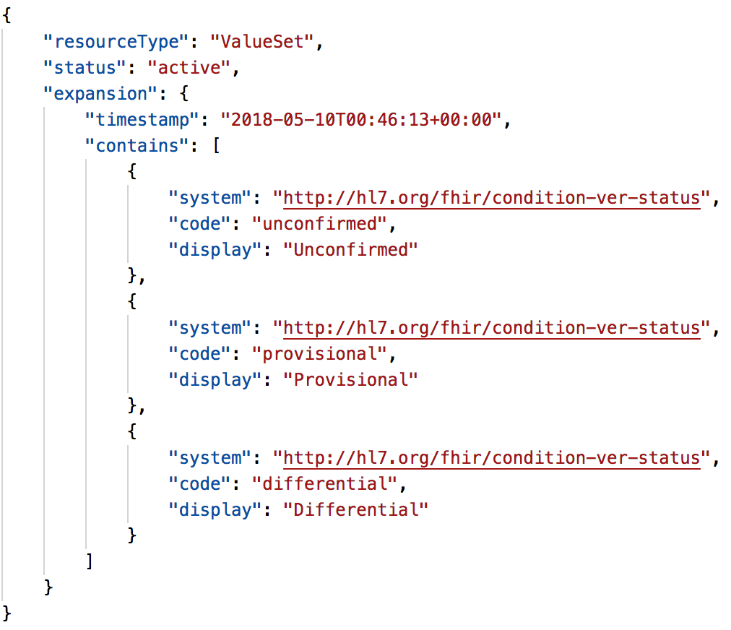
Expansion example

Slide 48
More terminology resources
48

Slide 49
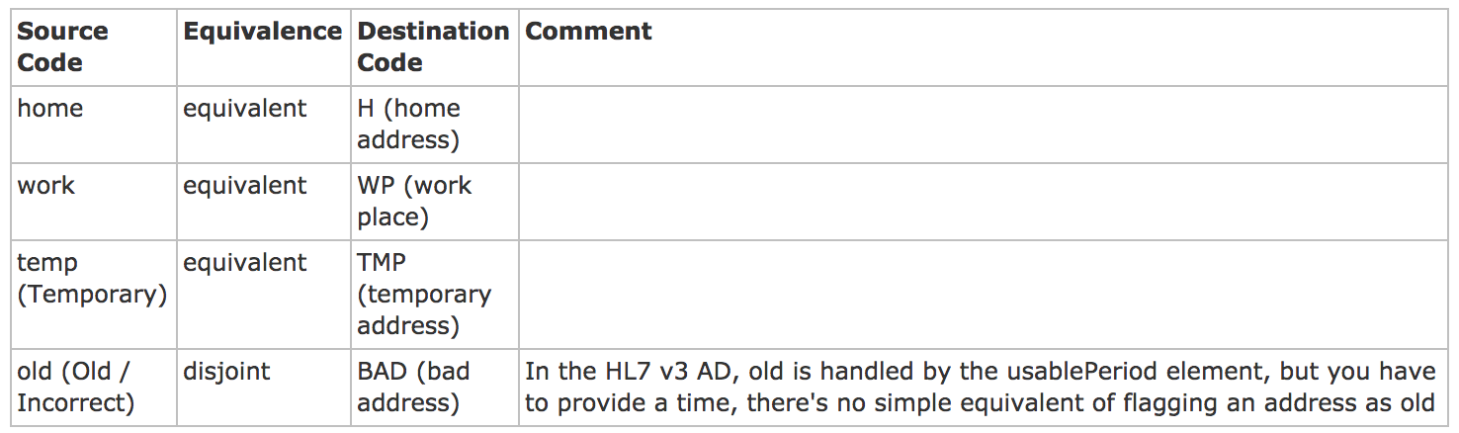
ConceptMap
A list of mappings between concepts from two different value sets (normally from different code systems or models) (UML)
Mapping data for the $translate operation (more on this later)
A mapping between the FHIR and HL7 v3 AddressUse Code systems

Slide 50
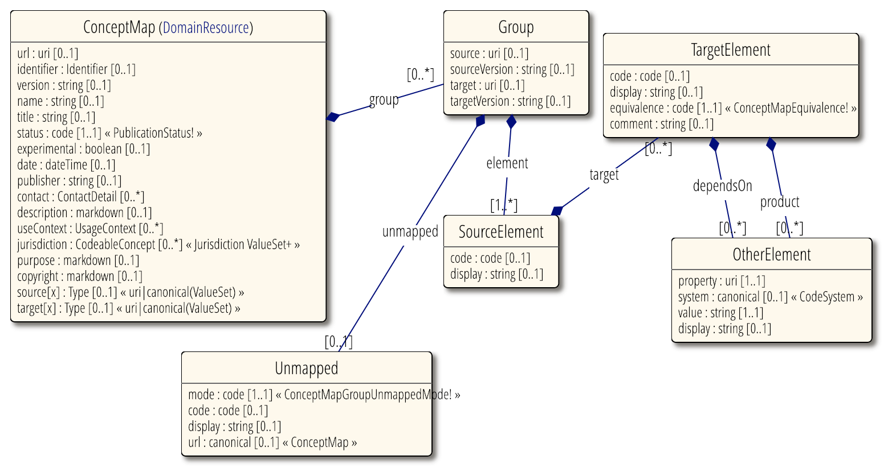
ConceptMap UML

Slide 51
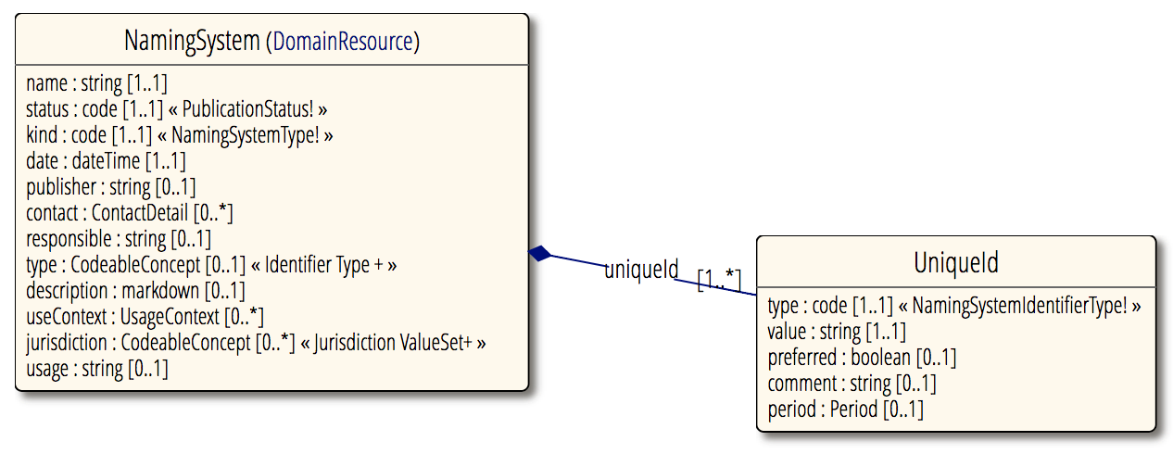
NamingSystem
Identifies the existence of a code or identifier system
Typically defined by 3rd parties (other than the code or identifier system "owner”)
51

Slide 52
TerminologyCapabilities
Provides the ability for a terminology server to describe the details of what the terminology service supports
Resource added in R4 (FMM 0)
In addition to the overall server capability statement (CapabilityStatement resource)
Server ‘/metadata’ endpoint
Return server terminology capabilities
GET [base]/metadata?mode=terminology

Slide 53
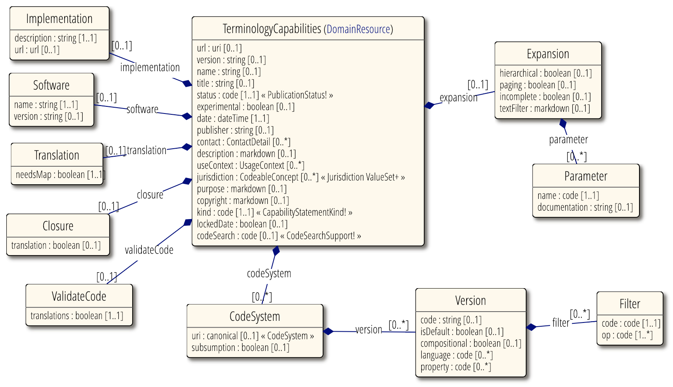
TerminologyCapabilities UML

Slide 54
ExpansionProfile
This resource was removed in R4!
All equivalent functionality is now incorporated in the $expand operation
Allows a terminology service client to configure the behavior of the terminology server in regard to:
How it builds value set expansions
How it validates codes in relation to the value set

Slide 55
Tutorial Learning Objectives
Understand how coded data is represented in data types and model elements and is exchanged in FHIR resources
Know how code systems and value sets in FHIR are defined and understand how they are used
Understand terminology binding and how to specify and use it correctly in FHIR models (resources and profiles)
Use FHIR terminology-based searching to find resources based on the content and properties of the coded data

Slide 56
Tutorial Learning Objectives (cont.)
Be able to understand and use FHIR Terminology Service capabilities (operations) in multiple scenarios
(e.g., terminology validation, user interface concept selection)

Slide 57
Terminology-based Search
57

Slide 58
Search parameters
Token
Exact match: system|code (SNOMED CT|Hypertensive disorder)
https://fhir.hausamconsulting.com/baseR4/Condition?code=http%3A%2F%2Fsnomed.info%2Fsct%7C38341003
Code, any system: code (LOINC Body weight Measured)
http://fhirtest.uhn.ca/baseDstu3/Observation?code=3141-9

Slide 59
Search parameters
Token
System, any code: system| (SNOMED CT)
http://fhirtest.uhn.ca/baseDstu3/AllergyIntolerance?code=http%3A%2F%2Fsnomed.info%2Fsct%7C
No system property exists, code: |code
http://fhir.hausamconsulting.com/baseR4/AllergyIntolerance?code=%7Callergy4387
This is expected to be quite rare
Why would you want to do this?

Slide 60
Search parameters
Modifiers
Search on CodeableConcept.text or Coding.display or Identifier.type.text: text
http://fhirtest.uhn.ca/baseDstu3/Condition?code:text=angina
http://fhirtest.uhn.ca/baseDstu3/Condition?code:text=angin
http://fhirtest.uhn.ca/baseDstu3/AllergyIntolerance?code:text=aspirin
Exclude resources that match based on token: not
http://fhirtest.uhn.ca/baseDstu3/Condition?severity:not=255604002
255604002 = “Mild”

Slide 61
Search parameters
Value Set-based Modifiers
Code in value set: in
http://fhir.hausamconsulting.com/baseR4/Condition?code:in=http%3A%2F%2Ffhir.hausamconsulting.com%2FbaseR4%2FValueSet%2Fupper-respiratory-infection
Code not in value set: not-in
http://fhir.hausamconsulting.com/baseR4/Condition?code:not-in=http%3A%2F%2Ffhir.hausamconsulting.com%2FbaseR4%2FValueSet%2Fupper-respiratory-infection
[unable to test ‘not-in’ with current HAPI and other server implementations]

Slide 62
Search parameters
Subsumption-based Modifiers
Code in a resource subsumes the specified search code (e.g. is-a* relationship): below “Diabetes mellitus” (73211009)
http://fhirtest.uhn.ca/baseDstu3/Condition?code:below=http://snomed.info/sct|73211009
Code in a resource is subsumed by the specified search code (e.g. is-a* relationship): above “Diabetes mellitus type 2 without retinopathy” (1481000119100)
http://fhirtest.uhn.ca/baseDstu3/Condition?code:above=http://snomed.info/sct|1481000119100
*is-a relationship includes the code itself

Slide 63
Terminology SERVICE
63

Slide 64
Terminology Service Rationale
There’s a lot of complexity here:
Code Systems
Value Sets
Bindings
Many (or most) applications are much simpler
List of codes and displays in some table structure
This is a known problem

Slide 65
Terminology Service Rationale
Delegate the complexity to specialist software
Provide a set of services that do what applications need
It becomes easy to write applications that do terminology well

Slide 66
Application Needs
Give me a list of codes
e.g., to populate my dropdown list
Is this code valid?
e.g., is the code that I received from an outside source a member of the required value set?
How do I display a code?
e.g., I need to show the preferred display term for my application context

Slide 67
Application Needs
Translate this code to a different code system
e.g., I coded the diagnosis in SNOMED CT and now I need to submit the claim in ICD-10
Integrate terminology search into my application
e.g., my type-ahead search to enter data into the allergy list needs the value set expansion for the list of codes that should be included

Slide 68
Terminology Service Operations - Overview
ValueSet
$expand
$validate-code
CodeSystem
$lookup
$subsumes
$find-matches
$validate-code
ConceptMap
$translate
$closure
Renamed in R4 – previously $compose
Operation was already included in ValueSet, but is also a new addition for CodeSystem in R4

Slide 69
$expand
Takes a ValueSet reference or resource and returns another ValueSet resource containing the expansion (code set)
Default is the current expansion (as of “now”)
http://....ValueSet/someValueSetId/$expand
http://...ValueSet$expand?url=[someURL]
http://...ValueSet (pass ValueSet in body)
$expand operation parameters
Used to configure the behaviour of a terminology server when it processes ValueSet resources to generate expansions

Slide 70
$expand (cont.)
Some additional parameters include:
filter: Only include concepts with display name containing string
This is a good way to search for a code
date: Generate the expansion as of the specified date

Slide 71
$expand examples
Extensional value set definition (enumerated list)
http://fhirtest.uhn.ca/baseDstu3/ValueSet/procedure-category
http://fhirtest.uhn.ca/baseDstu3/ValueSet/procedure-category/$expand

Slide 72
$expand examples (cont.)
Intensional value set definition (code system query based)
“All codes”
http://fhirtest.uhn.ca/baseDstu3/ValueSet/observation-category
http://fhirtest.uhn.ca/baseDstu3/ValueSet/observation-category/$expand
“is-a” hierarchy
http://fhirtest.uhn.ca/baseDstu3/ValueSet/route-codes
284009009 = “Route of administration value”
http://fhirtest.uhn.ca/baseDstu3/ValueSet/route-codes/$expand

Slide 73
$validate-code
Takes a code/Coding/CodeableConcept and checks if it’s valid against a value set or a code system (as of R4)
Specify value set (same as for $expand)
Code to validate – either code+system (with or without version, display), Coding or CodeableConcept
date – date to validate as of
Outputs: true/false
message if not valid, display names if valid
The primary method for validating coded data

Slide 74
$validate-code example
FHIR condition-category “problem-list-item” (ValueSet)
http://fhirtest.uhn.ca/baseDstu3/ValueSet/$validate-code?url=http://hl7.org/fhir/ValueSet/condition-category&system=http://hl7.org/fhir/condition-category&code=problem-list-item
SNOMED CT “Pneumonia” (233604007) (CodeSystem)
http://its.patientsfirst.org.nz/RestService.svc/Terminz/CodeSystem/$validate-code?system=http://snomed.info/sct&code=233604007
Note: It is easier to view the Terminz server output in Postman or another tool

Slide 75
$lookup
Takes a code+system(version) or Coding and returns additional details about the concept
Name, version, preferred display string, properties (including subproperties) and designations (additional representations for the concept)
Some additional parameters include:
property: Only include concepts with display name containing string
date: return information as of the specified date

Slide 76
$lookup
$lookup can also be used to determine whether a code exists in the CodeSystem
Similar capability to using $validate-code with CodeSystem, but returns an OperationOutcome (error) if the code does not exist
Returns the details if the lookup is successful
Only needs one operation, rather than two

Slide 77
$lookup example
SNOMED CT “Pneumonia” (233604007)
Note: Different servers will display different details
http://fhirtest.uhn.ca/baseDstu3/CodeSystem/$lookup?system=http://snomed.info/sct&code=233604007
http://tx.fhir.org/r3/CodeSystem/$lookup?system=http://snomed.info/sct&code=233604007
http://its.patientsfirst.org.nz/RestService.svc/Terminz/CodeSystem/$lookup?system=http://snomed.info/sct&code=233604007

Slide 78
$subsumes
Test whether codeA / codingA subsumes (or is subsumed by) codeB / codingB
Based on the semantics of subsumption in the underlying code system (e.g. SNOMED CT)
Returns one of four possible codes:
equivalent, subsumes, subsumed-by, and not-subsumed
If unable to determine the relationship between codes, returns an error

Slide 79
$subsumes example
SNOMED CT “Viral hepatitis” (3738000), “Disorder of liver” (235856003)
http://tx.fhir.org/r3/CodeSystem/$subsumes?system=http://snomed.info/sct&codeA=3738000&codeB=235856003
http://tx.fhir.org/r3/CodeSystem/$subsumes?system=http://snomed.info/sct&codeA=235856003&codeB=3738000

Slide 80
$translate
Can you translate this code to another code system?
Uses ConceptMap to translate the code(s)
http://...ConceptMap/id$translate
code, Coding or CodeableConcept passed (as per $validate-code)
Output:
True if can be translated
Message if can’t be translated
Translated coding if it can be translated

Slide 81
$translate example
FHIR address-use to V3 AddressUse value sets (tx.fhir.org)
http://tx.fhir.org/r3/ConceptMap/cm-address-use-v2/$translate?system=http://hl7.org/fhir/address-use&code=home&source=http://hl7.org/fhir/ValueSet/address-use&target=http://hl7.org/fhir/ValueSet/v3-AddressUse
ConceptMap resource used in the example: http://tx.fhir.org/r3/ConceptMap/cm-address-use-v2

Slide 82
$translate example
FHIR address-use to V3 AddressUse value sets (Terminz)
http://its.patientsfirst.org.nz/RestService.svc/Terminz/ConceptMap/$translate?system=http://hl7.org/fhir/address-use&code=home&source=http://hl7.org/fhir/ValueSet/address-use&target=http://terminology.hl7.org/ValueSet/v3-AddressUse
ConceptMap resource used in the example: http://its.patientsfirst.org.nz/RestService.svc/Terminz/ConceptMap?source=http://hl7.org/fhir/ValueSet/address-use&target=http://terminology.hl7.org/ValueSet/v3-AddressUse

Slide 83
Some Useful Ideas
Paging
Search results can be paged
http://hl7.org/fhir/search.html, see the _count parameter
$expand results have a separate paging mechanism (count, offset)
May improve performance by requesting specific elements
‘includeDefinition’ or ‘includeDesignations’ on $expand
‘property’ to specify which properties to return on $lookup
‘_elements’ to request specific elements to be returned on search/read operation results

Slide 84
Other Useful Ideas
Batch Processing
Many terminology operations are small
It maybe more efficient to send them as a batch and deal with the result when it comes back
http://hl7.org/fhir/http.html#transaction
Manage content types (Content-Type, Accept, _format)
JSON or XML
Accept-Encoding: gzip

Slide 85
Scenarios and strategies for using Terminology serviceS
85

Slide 86
Data entry interface
Choose code systems (ideally standard)
Choose or define value sets
For small value sets, populate a picklist using $expand
For large value sets, may use $expand?filter=xxx for type-ahead search

Slide 87
Creating a profile
Choose or define the code systems and value sets
Determine the binding strength
Set up the code system and value set maintenance and update processes
Concepts can become deprecated over time – watch for this!
You may be able to use ConceptMaps to find the concepts that have changed

Slide 88
Analyzing or validating coded data
Choose or define the code systems and value sets
Use $validate-code to check whether the codes are valid in your context, and whether the display text is correct
Clinical systems often allow users to change the display term
Use $translate to map local or non-standard coded data to the standard code systems / value sets for analysis
You may want to use an inline ValueSet with $subsumes or $validate-code (or $closure) for categorizing data

Slide 89
Exploring concept relationships
You can use $lookup to retrieve the properties and display them in a table (or other useful format)
You can navigate the hierarchy between concepts using the ‘child’ and ‘parent’ properties or by $subsumes (or $closure)

Slide 90
Tutorial Learning Objectives
Understand how coded data is represented in data types and model elements and is exchanged in FHIR resources
Know how code systems and value sets in FHIR are defined and understand how they are used
Understand terminology binding and how to specify and use it correctly in FHIR models (resources and profiles)
Use FHIR terminology-based searching to find resources based on the content and properties of the coded data

Slide 91
Tutorial Learning Objectives (cont.)
Be able to understand and use FHIR Terminology Service capabilities (operations) in multiple scenarios
(e.g., terminology validation, user interface concept selection)

Slide 92
Final Questions and Answers
Has this answered your questions?
Let’s review the list
How do you expect to use terminology and terminology services in your applications?

Slide 93
References for Servers and tools
93

Slide 94
Some Publicly Available Terminology Servers
Health Intersections (Grahame Grieve)
http://tx.fhir.org/r3
http://tx.fhir.org/r4
HAPI (University Health Network – James Agnew)
http://fhirtest.uhn.ca/home?serverId=home_21&pretty=true
http://fhirtest.uhn.ca/home?serverId=home_r4&pretty=true
OntoServer (CSIRO – Australia – Michael Lawley)
https://ontoserver.csiro.au/
https://ontoserver.csiro.au/stu3-latest

Slide 95
Some Publicly Available Terminology Servers
Value Set Authority Center (VSAC) – US National Library of Medicine (NLM)
https://cts.nlm.nih.gov/fhir/
Terminz (Patients First – New Zealand – Peter Jordan)
http://its.patientsfirst.org.nz/RestService.svc/Terminz
Link to other publicly available FHIR servers (general and terminology)
http://wiki.hl7.org/index.php?title=Publicly_Available_FHIR_Servers_for_testing

Slide 96
Some Useful Tools
clinFHIR (David Hay)
CodeSystem builder
http://clinfhir.com/codeSystem.html
ValueSet explorer
http://clinfhir.com/valuesetCreator.html
Query Tool
http://clinfhir.com/query.html
Postman
https://www.getpostman.com/

Slide 97
Some Useful Tools (cont.)
Shrimp SNOMED CT browser (CSIRO)
http://ontoserver.csiro.au/shrimp
CSIRO Value Set Comparison Tool
http://ontoserver.csiro.au/vstool
FHIR Tools release page
http://www.healthintersections.com.au/FhirServer/

Slide 98
More Questions?
Connect with the FHIR community: FHIR Zulip chat terminology stream
https://chat.fhir.org/#narrow/stream/terminology
Or ask me: Rob Hausam
rob@hausamconsulting.com
If you would like to be notified and receive updates to the presentation, send me your email address.

Slide 99
BONUS TOPICS
99

Slide 100
Bonus Topics (time and interest permitting)
Implicit value sets
$find-matches
$closure

Slide 101
Implicit Value Sets
Implicit value sets are those whose specification can be predicted based on the grammar of the underlying code system, and the known structure of the URL that identifies them
Example - SNOMED CT has common sets of implicit value sets defined:
By Subsumption, By Reference Set, etc.
See http://hl7.org/fhir/snomedct.html#implicit

Slide 102
Implicit Value Sets (cont.)
Implicit value sets do not use complex queries
Allows a single URL to serve as a value set definition that defines a value set, and can serve as the basis for the $expansion operation

Slide 103
Implicit Value Set $expand Example URL
SNOMED CT subtypes of “Pneumonia” (233604007)
https://ontoserver.csiro.au/stu3-latest/ValueSet/$expand?url=http%3A%2F%2Fsnomed.info%2Fsct%3Ffhir_vs=isa%2F233604007
http://tx.fhir.org/r3/ValueSet/$expand?url=http%3A%2F%2Fsnomed.info%2Fsct%3Ffhir_vs%3Disa%2F233604007
http://its.patientsfirst.org.nz/RestService.svc/Terminz/ValueSet/$expand?url=http%3A%2F%2Fsnomed.info%2Fsct%3Ffhir_vs%3Disa%2F233604007

Slide 104
$find-matches (formerly $compose)
Given a set of properties (and text), return one or more possible matching codes
This operation takes a set of properties, and examines the code system looking for codes in the code system that match a set of known properties.
Example use:
SNOMED Composition - provide multiple properties, and ask for a single pre-coordinated code that represents the whole

Slide 105
Closure – why do we need it?
Find any observations for male patients over the age of 50 who attended a particular clinic within a particular 2 week period, with a diagnosis of gout, and who had an elevated serum creatinine
Some of this is terminology based, some isn’t
How do you make this work?

Slide 106
Closure – the problem and the FHIR approach
Both "diagnosis of gout" and "serum creatinine" involve value set and/or subsumption queries (against SNOMED CT and LOINC respectively)
Generate a subsumption closure table on the fly, as new codes are seen
Terminology server does terminological reasoning
Client does closure table maintenance

Slide 107
$closure
For every new code encountered by the client in a context:
Ask the server what relationships exist with codes already in that context
Put them all in a ‘closure’ table
Concept table (key : system : code : display)
Closure table (keySource, keyDest)
Can include joins on this table as part of other queries

